Slide 1
Boolean Algebra and Logic Gate

Slide 2
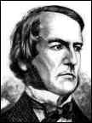
George Boole
Father of Boolean algebra
He came up with a type of linguistic algebra, the three most basic operations of which were (and still are) AND, OR and NOT. It was these three functions that formed the basis of his premise, and were the only operations necessary to perform comparisons or basic mathematical functions.
Boole’s system was based on a binary approach, processing only two objects - the yes-no, true-false, on-off, zero-one approach.
Surprisingly, given his standing in the academic community, Boole's idea was either criticized or completely ignored by the majority of his peers.
Eventually, one bright student, claude shunnon(1916-2001), picked up the idea and ran with it
George Boole (1815 - 1864)

Slide 3
Axiomatic Definition of Boolean Algebra
We need to define algebra for binary values
Developed by George Boole in 1854
Huntington postulates (1904) for Boolean algebra :
B = {0, 1} and two binary operations, (+) and (.)
Closure with respect to operator (+) and operator (.)
Identity element 0 for operator (+) and 1 for operator (.)
Commutativity with respect to (+) and (.)
x+y = y+x, x·y = y·x
Distributivity of (.) over (+), and (+) over (.)
x·(y+z) = (x·y)+(x·z) and x+(y·z) = (x+y)·(x+z)
Complement for every element x is x’ with x+x’=1, x·x’=0
There are at least two elements x,y∈B such that x≠y

Slide 4
Boolean Algebra
Terminology:
Literal: A variable or its complement
Product term: literals connected by (·)
Sum term: literals connected by (+)

Slide 5
Postulates of Boolean Algebra
B = {0, 1} and two binary operations, (+) and (.)
The rules of operations: AND, OR and NOT.
Closure (+ and‧)
The identity elements
(1) + = 0
(2) · = 1
AND
OR
NOT
x | y | X.y
0 | 0 | 0
0 | 1 | 0
1 | 0 | 0
1 | 1 | 1
x | y | x+y
0 | 0 | 0
0 | 1 | 1
1 | 0 | 1
1 | 1 | 1
x | X’
0 | 1
1 | 0

Slide 6
Postulates of Boolean Algebra
The commutative laws x+y = y+x, x.y = y.x
The distributive laws
x | y | z | y+z | x．(y+z) | x．y | x．z | (x．y)+(x．z)
0 | 0 | 0 | 0 | 0 | 0 | 0 | 0
0 | 0 | 1 | 1 | 0 | 0 | 0 | 0
0 | 1 | 0 | 1 | 0 | 0 | 0 | 0
0 | 1 | 1 | 1 | 0 | 0 | 0 | 0
1 | 0 | 0 | 0 | 0 | 0 | 0 | 0
1 | 0 | 1 | 1 | 1 | 0 | 1 | 1
1 | 1 | 0 | 1 | 1 | 1 | 0 | 1
1 | 1 | 1 | 1 | 1 | 1 | 1 | 1

Slide 7
Postulates of Two-Valued Boolean Algebra
Complement
x+x'=1 → 0+0'=0+1=1; 1+1'=1+0=1
x．x'=0 → 0．0'=0．1=0; 1．1'=1．0=0
Has two distinct elements 1 and 0, with 0 ≠ 1
Note
A set of two elements
(+) : OR operation; (·) : AND operation
A complement operator: NOT operation
Binary logic is a two-valued Boolean algebra

Slide 8
Duality
The principle of duality is an important concept. This says that if an expression is valid in Boolean algebra, the dual of that expression is also valid.
To form the dual of an expression, replace all (+) operators with (·) operators, all (·) operators with (+) operators, all ones with zeros, and all zeros with ones.
Following the replacement rules…
a(b + c) = ab + ac
Form the dual of the expression
a + (bc) = (a + b)(a + c)
Take care not to alter the location of the parentheses if they are present.

Slide 9
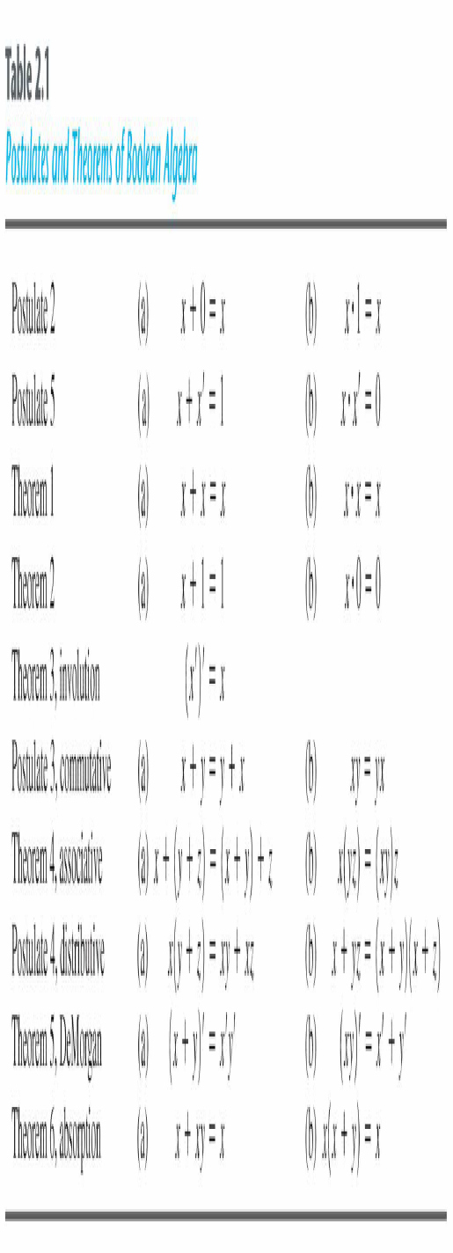
Basic Theorems

Slide 10
Proof of x+x=x
Huntington postulates:
Post. 2: (a) x+0=x, (b) x·1=x
Post. 3: (a) x+y=y+x, (b) x·y=y·x
Post. 4: (a) x(y+z) = xy+xz, (b) x+yz = (x+y)(x+z)
Post. 5: (a) x+x’=1, (b) x·x’=0
We can only use Huntington postulates:
Show that x+x=x.
x+x = (x+x)·1 by 2(b)
= (x+x)(x+x’) by 5(a)
= x+xx’ by 4(b)
= x+0 by 5(b)
= x by 2(a)
Q.E.D.
We can now use Theorem 1(a) in future proofs

Slide 11
Absorption Property
Theorem 6(a): x + xy = x
x + xy = x．1 + xy by 2(b)
= x (1 + y) 4(a)
= x (y + 1) 3(a)
= x．1 Th 2(a)
= x 2(b)
Theorem 6(b): x (x + y) = x by duality
By means of truth table (another way to proof )
Huntington postulates:
Post. 2: (a) x+0=x, (b) x·1=x
Post. 3: (a) x+y=y+x, (b) x·y=y·x
Post. 4: (a) x(y+z) = xy+xz, (b) x+yz = (x+y)(x+z)
Post. 5: (a) x+x’=1, (b) x·x’=0
Th. 2: (a) x+1=1
x | y | xy | x+xy
0 | 0 | 0 | 0
0 | 1 | 0 | 0
1 | 0 | 0 | 1
1 | 1 | 1 | 1

Slide 12
DeMorgan’s Theorem
Theorem 5(a): (x + y)’ = x’y’
Theorem 5(b): (xy)’ = x’ + y’
By means of truth table
x | y | x’ | y’ | x+y | (x+y)’ | x’y’ | xy | x’+y' | (xy)’
0 | 0 | 1 | 1 | 0 | 1 | 1 | 0 | 1 | 1
0 | 1 | 1 | 0 | 1 | 0 | 0 | 0 | 1 | 1
1 | 0 | 0 | 1 | 1 | 0 | 0 | 0 | 1 | 1
1 | 1 | 0 | 0 | 1 | 0 | 0 | 1 | 0 | 0

Slide 13
Consensus Theorem
xy + x’z + yz = xy + x’z
(x+y)•(x’+z)•(y+z) = (x+y)•(x’+z) -- (dual)
Proof:
xy + x’z + yz
= xy + x’z + 1.yz 2(a)
= xy + x’z + (x+x’)yz 5(a)
= xy + x’z + xyz + x’yz 3(b) &4(a)
= (xy + xyz) + (x’z + x’zy) Th4(a)
= x(y + yz) + x’ (z + zy) 4(a)
= xy + x’z Th6(a)
QED (2 true by duality).

Slide 14
Operator Precedence
The operator precedence for evaluating Boolean Expression is
Parentheses
NOT
AND
OR
Examples
x y' + z
(x y + z)'

Slide 15
2.5 Boolean Functions
A Boolean function
Binary variables
Binary operators OR and AND
Unary operator NOT
Parentheses
Examples
F₁= x y z'
F₂ = x + y'z
F₃ = x' y' z + x' y z + x y'
F₄ = x y' + x' z

Slide 16
Boolean Functions
The truth table of 2^{n} entries (n=number of variables)
Two Boolean expressions may specify the same function
F₃ = F₄
x | y | z | F₁ | F₂ | F₃ | F₄
0 | 0 | 0 | 0 | 0 | 0 | 0
0 | 0 | 1 | 0 | 1 | 1 | 1
0 | 1 | 0 | 0 | 0 | 0 | 0
0 | 1 | 1 | 0 | 0 | 1 | 1
1 | 0 | 0 | 0 | 1 | 1 | 1
1 | 0 | 1 | 0 | 1 | 1 | 1
1 | 1 | 0 | 1 | 1 | 0 | 0
1 | 1 | 1 | 0 | 1 | 0 | 0

Slide 17
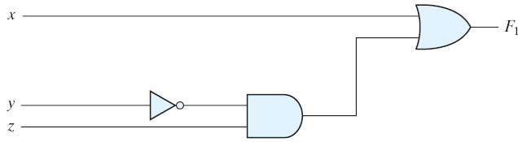
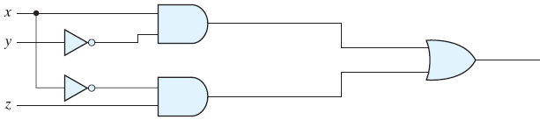
Boolean Functions
Implementation with logic gates
F₄ is more economical
F₂ = x + y'z
F₃ = x' y' z + x' y z + x y'
F₄ = x y' + x' z

Slide 18
Algebraic Manipulation
When a Boolean expression is implemented with logic gates, each term requires a gate and each variable (Literal) within the term designates an input to the gate. (F3 has 3 terms and 8 literal)
To minimize Boolean expressions, minimize the number of literals and the number of terms → a circuit with less equipment
It is a hard problem (no specific rules to follow)
Example 2.1
x(x'+y) = xx' + xy = 0+xy = xy
x+x'y = (x+x')(x+y) = 1 (x+y) = x+y
(x+y)(x+y') = x+xy+xy'+yy' = x(1+y+y') = x
xy + x'z + yz = xy + x'z + yz(x+x') = xy + x'z + yzx + yzx' = xy(1+z) + x'z(1+y) = xy +x'z
(x+y)(x'+z)(y+z) = (x+y)(x'+z), by duality from function 4. (consensus theorem with duality)

Slide 19
Complement of a Function
An interchange of 0's for 1's and 1's for 0's in the value of F
By DeMorgan's theorem
(A+B+C)' = (A+X)' let B+C = X
= A'X' by theorem 5(a) (DeMorgan's)
= A'(B+C)' substitute B+C = X
= A'(B'C') by theorem 5(a) (DeMorgan's)
= A'B'C' by theorem 4(b) (associative)
Generalization: a function is obtained by interchanging AND and OR operators and complementing each literal.
(A+B+C+D+ ... +F)' = A'B'C'D'... F'
(ABCD ... F)' = A'+ B'+C'+D' ... +F'

Slide 20
Examples
Example 2.2
F₁' = (x'yz' + x'y'z)' = (x'yz')' (x'y'z)' = (x+y'+z) (x+y+z')
F₂' = [x(y'z'+yz)]' = x' + (y'z'+yz)' = x' + (y'z')' (yz)‘
= x' + (y+z) (y'+z')
= x' + yz‘+y'z
Example 2.3: a simpler procedure
Take the dual of the function and complement each literal
F₁ = x'yz' + x'y'z.
The dual of F₁ is (x'+y+z') (x'+y'+z).
Complement each literal: (x+y'+z)(x+y+z') = F₁'
F₂ = x(y' z' + yz).
The dual of F₂ is x+(y'+z') (y+z).
Complement each literal: x'+(y+z)(y' +z') = F₂'

Slide 21
Canonical and Standard Forms
Minterms and Maxterms
A minterm (standard product): an AND term consists of all literals in their normal form or in their complement form.
For example, two binary variables x and y,
xy, xy', x'y, x'y'
It is also called a standard product.
n variables can be combined to form 2^{n} minterms.
A maxterm (standard sums): an OR term
It is also call a standard sum.
2^{n} maxterms.

Slide 22
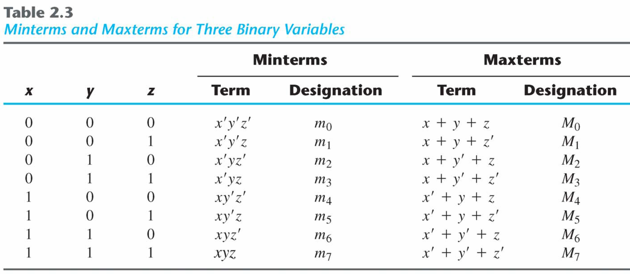
Minterms and Maxterms
Each maxterm is the complement of its corresponding minterm, and vice versa.

Slide 23
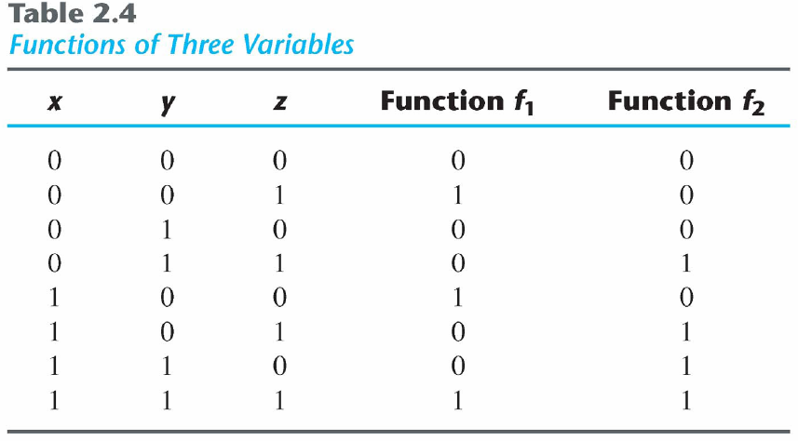
Minterms and Maxterms
A Boolean function can be expressed algebraically from a given truth table by forming a minterm for each combination of the variables that produces a 1 in the function and then taking the OR of all those terms.

Slide 24
Minterms and Maxterms
An Boolean function can be expressed by
A truth table
Sum of minterms for each combination of variables that produces a (1) in the function.
f₁ = x'y'z + xy'z' + xyz = m₁ + m₄ +m₇ (Minterms)
f₂ = x'yz+ xy'z + xyz'+xyz = m₃ + m₅ +m₆ + m₇ (Minterms)

Slide 25
Minterms and Maxterms
The complement of a Boolean function
The minterms that produce a 0
f₁' = m₀ + m₂ +m₃ + m₅ + m₆ = x'y'z'+x'yz'+x'yz+xy'z+xyz'
f₁ = (f₁')'
= (x+y+z)(x+y'+z) (x+y'+z') (x'+y+z')(x'+y'+z) = M₀ M₂ M₃ M₅ M₆
f₂ = (x+y+z)(x+y+z')(x+y'+z)(x'+y+z)=M₀M₁M₂M₄
Any Boolean function can be expressed as terms).
A product of maxterms (“product” meaning the ANDing of terms).
A sum of minterms (“sum” meaning the ORing of Both boolean functions are said to be in Canonical form.

Slide 26
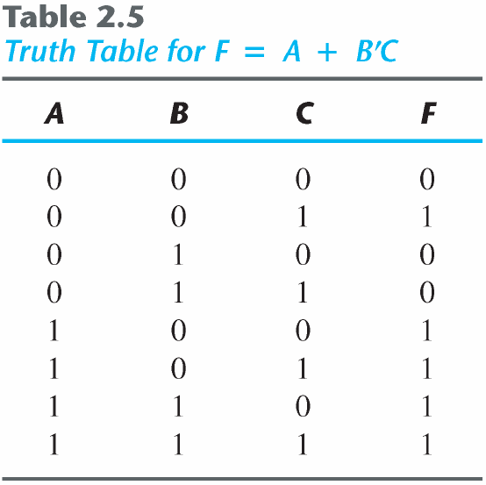
Sum of Minterms
Sum of minterms: there are 2^{n} minterms and 2^{2n} combinations of functions with n Boolean variables.
Example 2.4: express F = A+B’C as a sum of minterms.
F = A+B'C = A (B+B') + B'C = AB +AB' + B'C = AB(C+C') + AB'(C+C') + (A+A')B'C = ABC+ABC'+AB'C+AB'C'+A'B'C
F = A'B'C +AB'C' +AB'C+ABC'+ ABC = m₁ + m₄ +m₅ + m₆ + m₇
F(A, B, C) = Σ(1, 4, 5, 6, 7)
or, built the truth table first

Slide 27
Product of Maxterms
Product of maxterms: using distributive law to expand.
x + yz = (x + y)(x + z) = (x+y+zz')(x+z+yy') = (x+y+z)(x+y+z')(x+y'+z)
Example 2.5: express F = xy + x'z as a product of maxterms.
F = xy + x'z = (xy + x')(xy +z) = (x+x')(y+x')(x+z)(y+z) = (x'+y)(x+z)(y+z)
x'+y = x' + y + zz' = (x'+y+z)(x'+y+z')
F = (x+y+z)(x+y'+z)(x'+y+z)(x'+y+z') = M₀M₂M₄M₅
F(x, y, z) = Π(0, 2, 4, 5)

Slide 28
Conversion between Canonical Forms
The complement of a function expressed as the sum of minterms equals the sum of minterms missing from the original function.
F(A, B, C) = Σ(1, 4, 5, 6, 7)
Thus, F‘ (A, B, C) = Σ(0, 2, 3)
By DeMorgan's theorem
F(A, B, C) = Π(0, 2, 3)
F'(A, B, C) =Π (1, 4, 5, 6, 7)
m_{j}' = M_{j}
To convert from one canonical form to another: interchange the symbols Σ and Π and list those numbers missing from the original form
Σ of 1's
Π of 0's

Slide 29
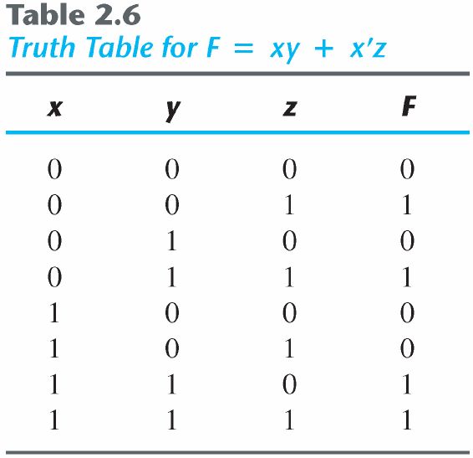
Example
F = xy + x′z
F(x, y, z) = Σ(1, 3, 6, 7)
F(x, y, z) = Π (0, 2, 4, 6)

Slide 30
Standard Forms
In canonical forms each minterm or maxterm must contain all the variables either complemented or uncomplemented, thus these forms are very seldom the ones with the least number of literals.
Standard forms: the terms that form the function may obtain one, two, or any number of literals, .There are two types of standard forms:
Sum of products: F₁ = y' + xy+ x'yz'
Product of sums: F₂ = x(y'+z)(x'+y+z')
A Boolean function may be expressed in a nonstandard form
F₃ = AB + C(D + E)
But it can be changed to a standard form by. using. The distributive law
F3 = AB + C(D + E) = AB + CD + CE

Slide 31
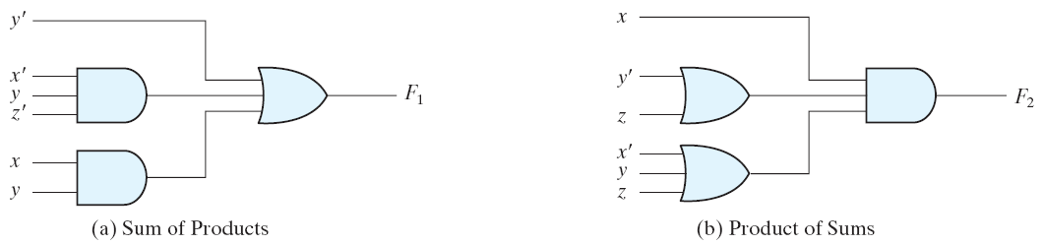
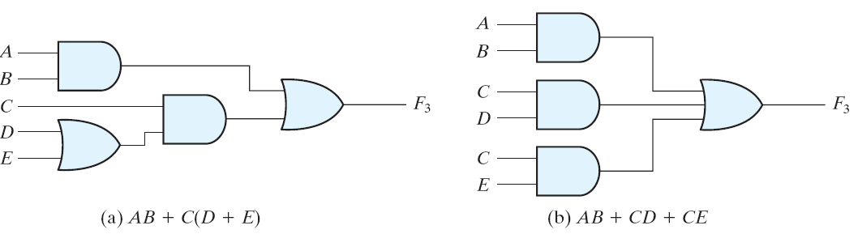
Implementation
Two-level implementation
Multi-level implementation
F₁ = y' + xy+ x'yz'
F₂ = x(y'+z)(x'+y+z')

Slide 32
2.8 Digital Logic Gates
Boolean expression: AND, OR and NOT operations
Constructing gates of other logic operations
The feasibility and economy;
The possibility of extending gate's inputs;
The basic properties of the binary operations (commutative and associative);
The ability of the gate to implement Boolean functions.

Slide 33
Summary of Logic Gates
Digital logic gates

Slide 34
Summary of Logic Gates
Digital logic gates

Slide 35
Multiple Inputs
Extension to multiple inputs
A gate can be extended to multiple inputs.
If its binary operation is commutative and associative.
AND and OR are commutative and associative.
OR
x+y = y+x
(x+y)+z = x+(y+z) = x+y+z
AND
xy = yx
(x y)z = x(y z) = x y z

Slide 36
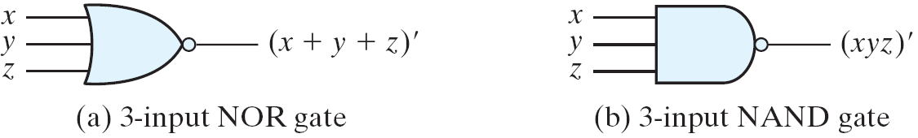
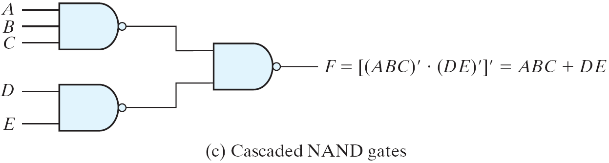
Multiple Inputs
Multiple NOR = a complement of OR gate, Multiple NAND = a complement of AND.
The cascaded NAND operations = sum of products.
The cascaded NOR operations = product of sums.
Multiple-input and cascaded NOR and NAND gates

Slide 37
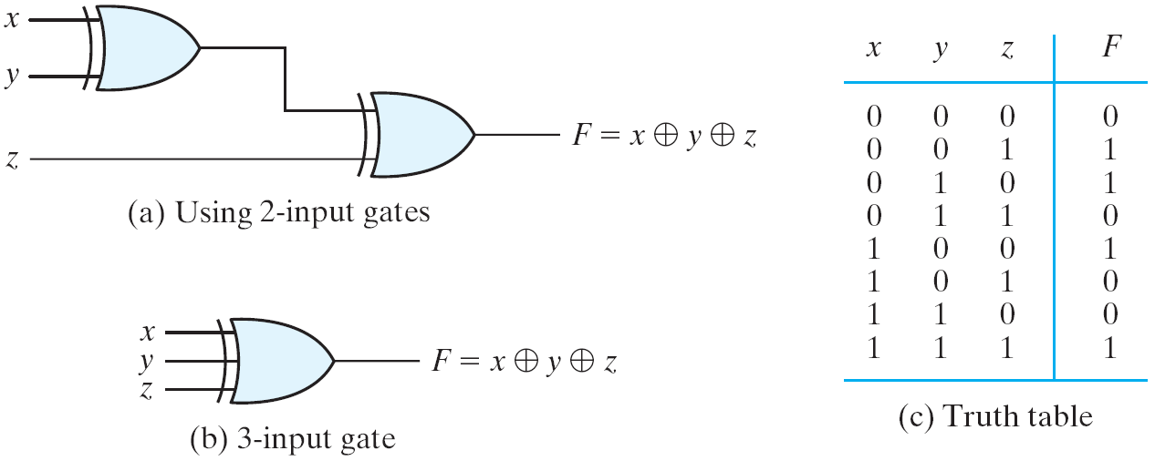
Multiple Inputs
The XOR and XNOR gates are commutative and associative.
Multiple-input XOR gates are uncommon?
XOR is an odd function: it is equal to 1 if the inputs variables have an odd number of 1's.
3-input XOR gate

Slide 38
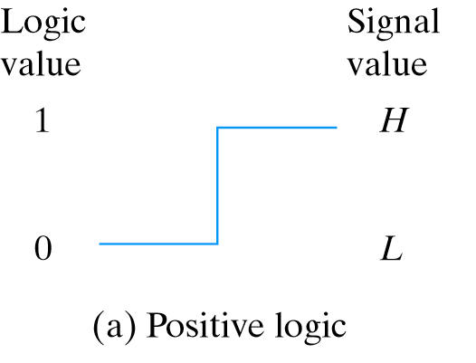

Positive and Negative Logic
Positive and Negative Logic
Two signal values <=> two logic values
Positive logic: H=1; L=0
Negative logic: H=0; L=1
Consider a TTL gates
A positive logic AND gate
A negative logic OR gate
Signal assignment and logic polarity

Slide 39
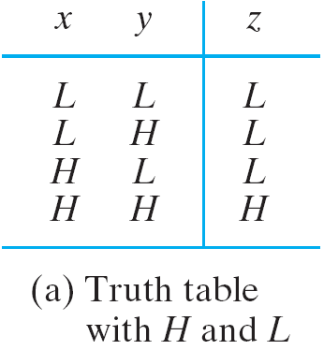
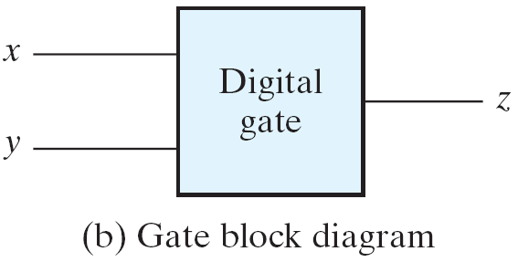
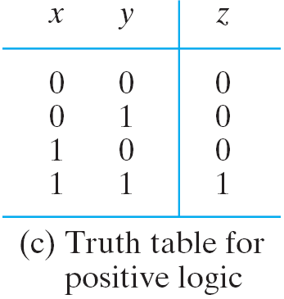
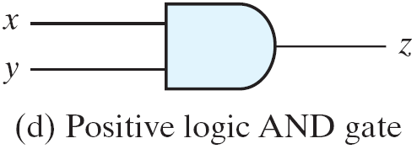
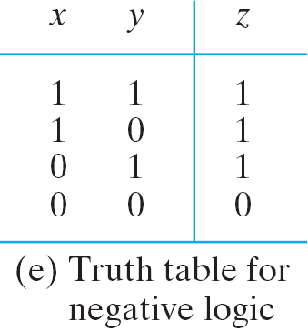
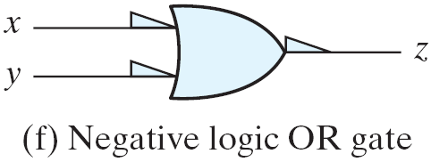
Positive and Negative Logic

Slide 40
Donot care terms
Functions that have unspecified outputs for some input combinations are called incompletely specified functions.
In most applications, we simply don’t care what value is assumed by the function for the unspecified minterms thus the unspecified minterms of a function are called don’t-care conditions.
These don’t-care conditions can be used on a map to provide further simplification of the Boolean expression.

Slide 41
Donot care terms
A don’t-care minterm is a combination of variables whose logical value is not specified.
Such a minterm cannot be marked with a 1 in the map, because it would require that the function always be a 1 for such a combination.
Likewise, putting a 0 on the square requires the function to be 0.
To distinguish the don’t-care condition from 1’s and 0’s, an X is used.
In choosing adjacent squares to simplify the function in a map, the don’t-care minterms may be assumed to be either 0 or 1.

